Slide 1
SQL Intro
Pre-lim to physical design

Slide 2
Human Readable (?)
Designed to resemble spoken English
Commands formulated with an ‘action verb’
Examples:
CREATE DATABASE toys;
USE toys;
SELECT id FROM toys WHERE targetAge > 3;
DELETE FROM toys WHERE productionStatus = "Revoked";
Easy eh!?

Slide 3
SQL Categories
Working with the Database:
Data Query Language (DQL)
Data Manipulation Language (DML)
Working with Database Schema
Data Definition Language (DDL)
Privileges and Access to the Database
Data Control Language (DCL)

Slide 4
Data Query Language (DQL)
Statements that query the database but do not alter any data or database objects.
This category contains the SELECT statement.
Because there really is only a single query statement, many lump DQL into DML (next)

Slide 5
Data Manipulation Language (DML)
Statements that modify data stored in database objects (that is, tables).
This category contains the
INSERT,
UPDATE,
DELETE.

Slide 6
Data Definition Language (DDL)
Statements that create and modify database objects.
DDL manages the data containers whereas DML manages the data inside the containers.
This category includes
CREATE,
ALTER,
DROP

Slide 7
Data Control Language (DCL)
Manage privileges that database users have regarding the database and objects stored in it.
This category includes
GRANT
REVOKE

Slide 8
DQL Statements
SELECT Lists the columns that are to be returned in the results
FROM Lists the tables or views from which data is to be selected
WHERE Provides conditions for the selection of rows in the results
GROUP BY Groups rows for various aggregate functions
ORDER BY Specifies the order in which rows are to be returned

Slide 9
Lets play ...
Jump on to MariaDB, log in, load mysql
Remember? mysql –u username –p
Attach to the sakila database:
use sakila;
Permission problems?

Slide 10
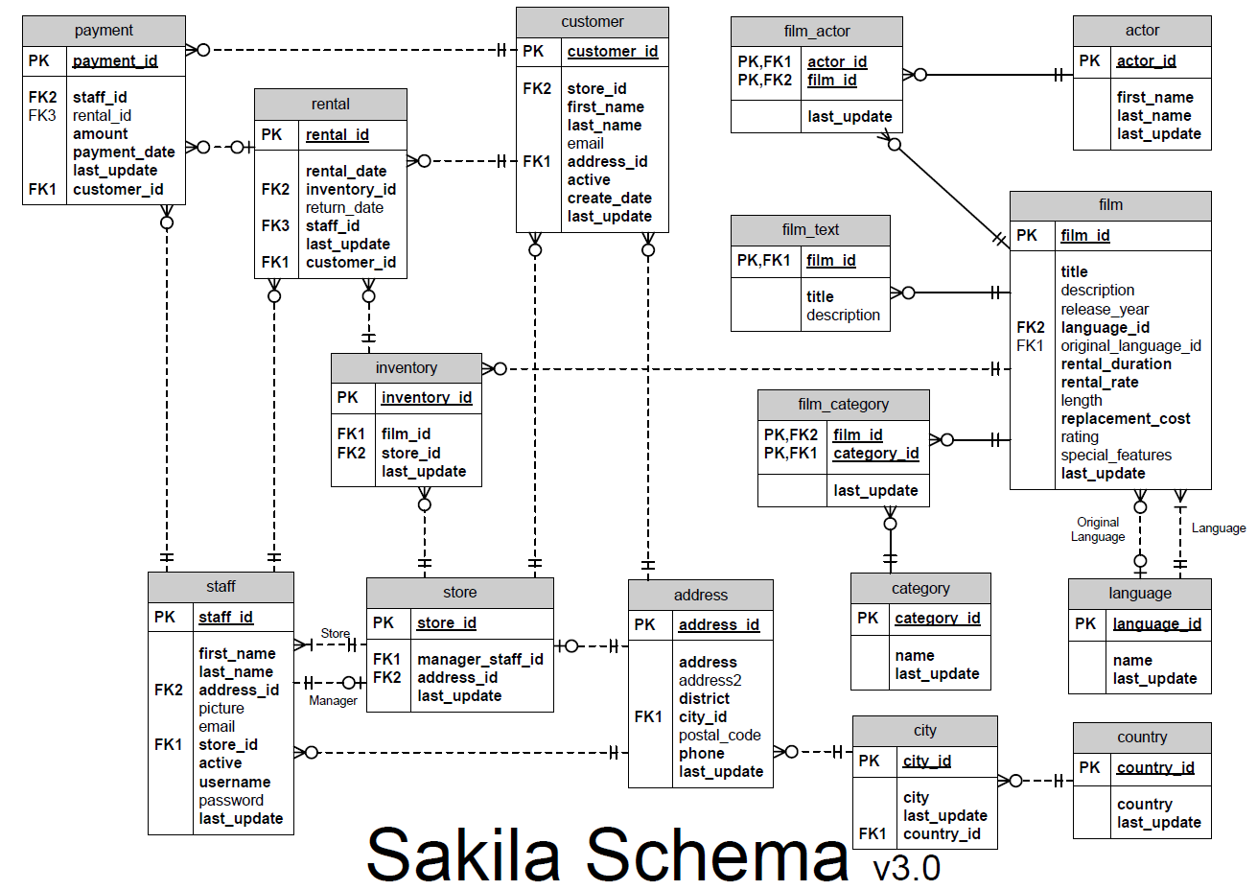
Sakila Schema

Slide 11
Schema
Take a look at the tables
show tables;
Interested in a table? Look at it closer ... Lets pick the “customer” table
desc customer;
Show create table customer;

Slide 12
Listing all rows and columns
select * from customer;
select * from actor;
select * from category;
select * from city;
select * from country;
select * from language;

Slide 13
Functions in statements
Some functions can be used in a select statement
select count(*) from customer;
Gives a count of the number of records in the customer table
Other functions:
Min()
Max()
Avg()

Slide 14
Limiting columns to display
select title, rating from film;
select first_name, last_name from staff;
Rename a title in the output
select first_name as ‘First Name’,
last_name as Surname from staff;
Note Single Quotes if using a space in the new name

Slide 15
Sorting Results
select first_name as FName,
last_name as Surname
from actor
order by last_name, first_name;
Now try that again but order in descending by adding “desc” to the surname
order by last_name desc, first_name;

Slide 16
Grouping results
You can group results and then use these aggregate functions.
Select count(*) from city;
But it you want a breakdown of how many cities for each country_id then you need to group the output
Select count(*), country_id
from city
group by country_id;

Slide 17
Choosing rows to display
Simple ‘where’
select first_name, last_name
from actor
where last_name = ‘Allen’;
Show the customers with the name “Smith”

Slide 18
Where ... Between
select *
from sometable
where value between x and y;
How many people have an “amount” in the payment table which is between $8 and $10?

Slide 19

like
Select * from table_name
Where attribute like string-pattern
String-pattern use wild-cards
_ (underscore) any single character
% any number of characters
Surround string pattern with single quotes

Slide 20
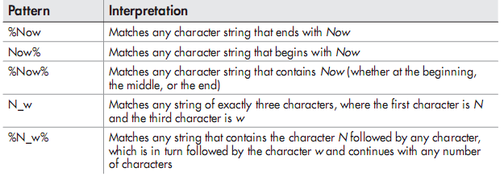
Like
How many customers start with “a”?

Slide 21
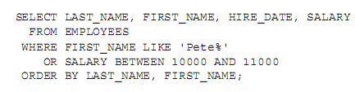

AND & OR

